Slide 1





Default of Credit Card Clients

Slide 2
History of Credit Card Reporting
In 1973, First credit card was issued in Taiwan
Has got a rapid expansion from years 2000
33 Credit banks are operating in Taiwan
Number of effective cards are 51.09 million among which the
total active cards are 33.34 million(end of March 2021)

Slide 3


Objectives
Investigate credit card defaults
Identify factors impacting credit card default
Analysis on credit card defaulters

Slide 4
Variables present in the data
User ID
Credit card limit
Sex
Education
Age
Marriage status
Defaulter status
Repayment amount
Bill amount

Slide 5
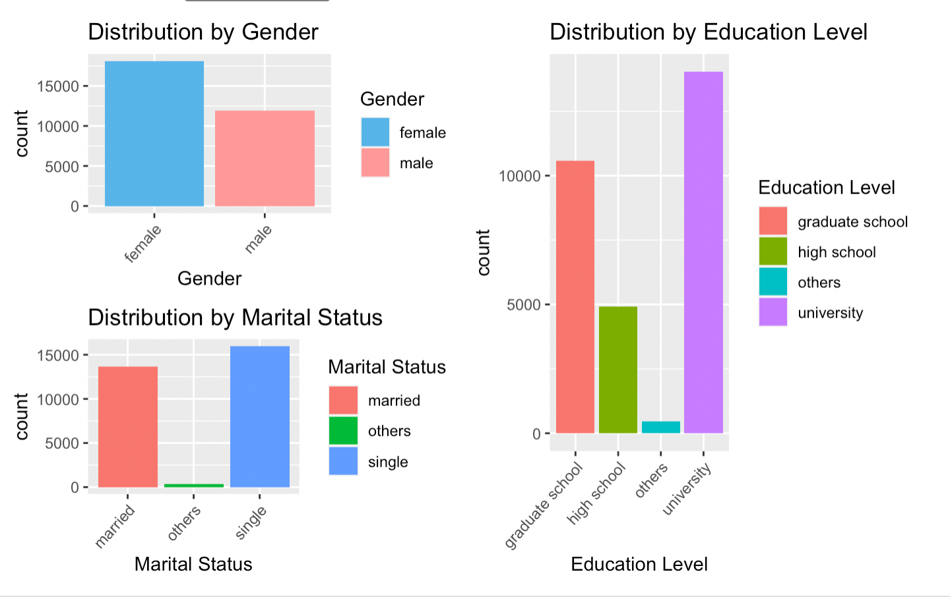
Understanding the data
The number of female customers are much higher compared to the male customers
The customers having a credit card were mostly educated people, either a University student or a Graduate student

Slide 6
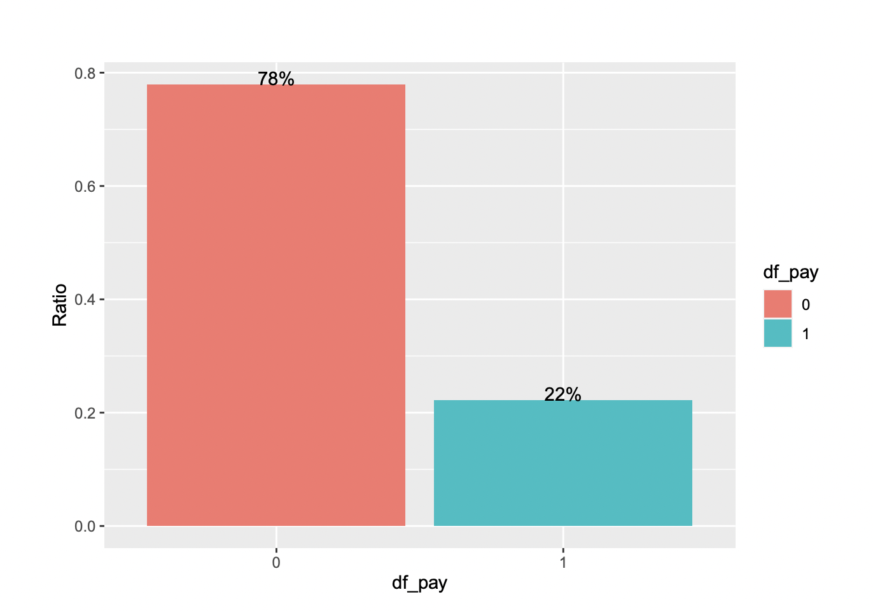
Probability of defaulters in the data
22% of the customers were predicted to be defaulters of the credit card bill payment
There is a lot of revenue loss for the company with these numbers, usually the defaulter ratio is less than 5% for most companies

Slide 7
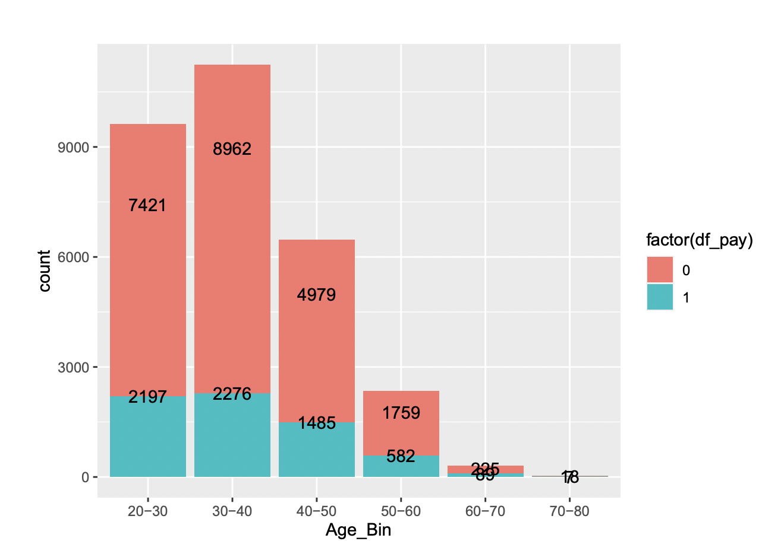
Age group to predict number of defaulters and Non defaulters
Most credit card customers lie in the age group of 20-50

Slide 8
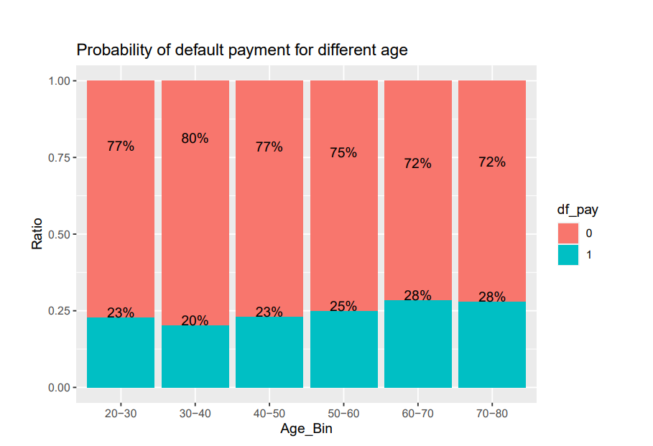
Age group to predict probability of defaulters and Non defaulters​
Even though it looks like younger population has more defaulters, after deep diving into the data we could see that age groups 50-80 have a higher percentage of defaulters​

Slide 9
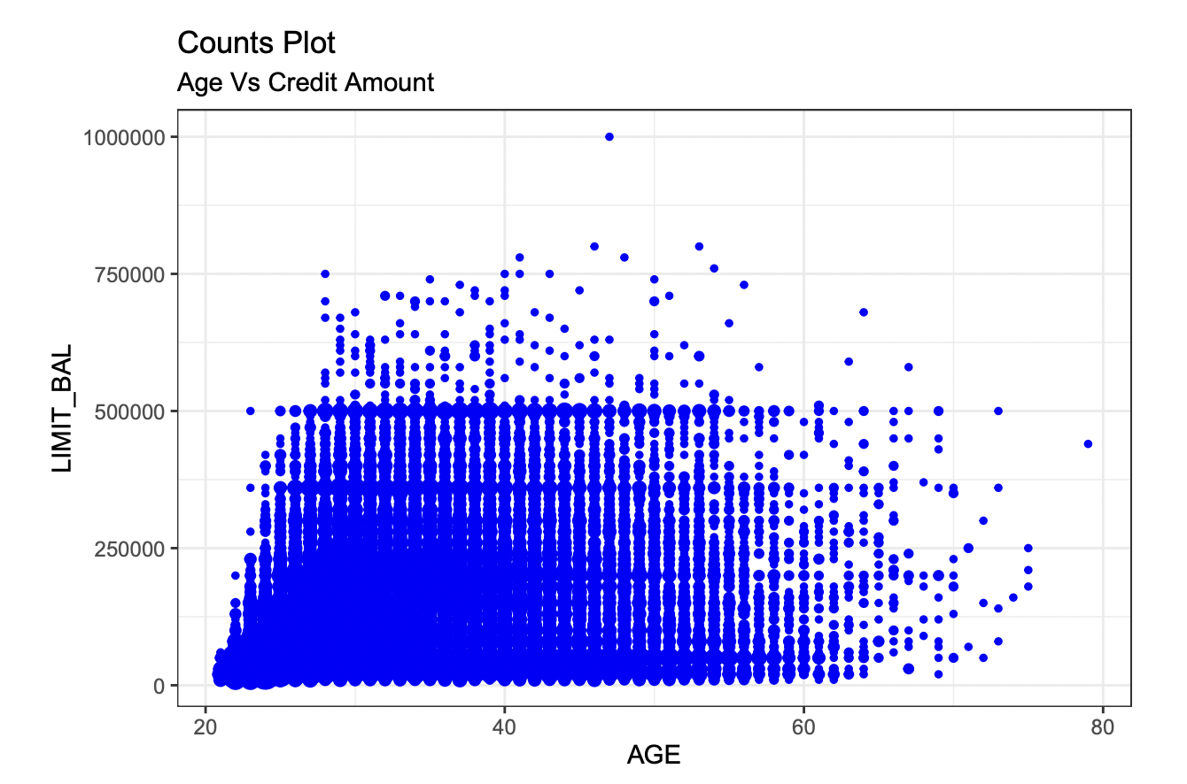
Impact of age on credit limit
The credit limit is lesser for the youngest population and the oldest population when compared to the middle age groups

Slide 10
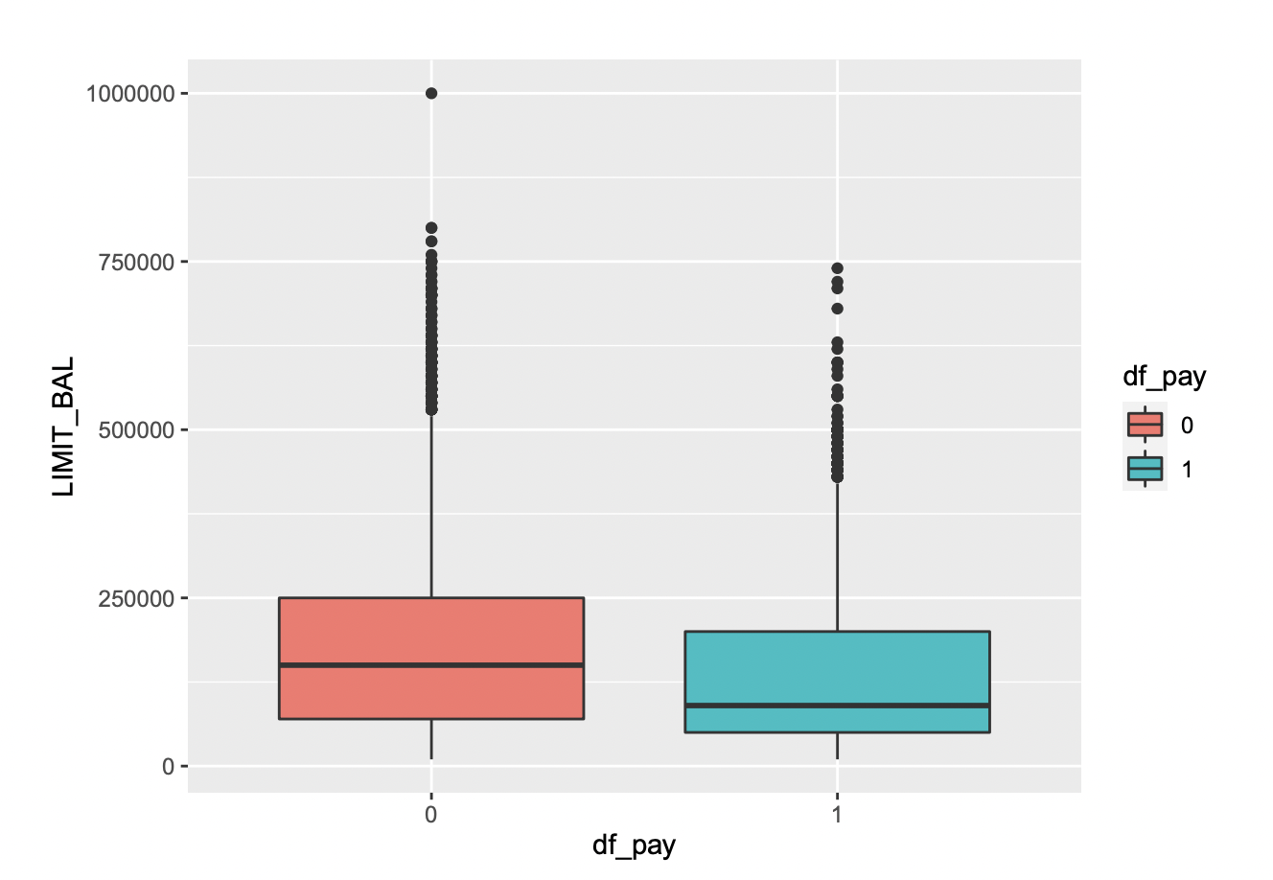
Credit card balance limit for normal customers vs defaulters
The average balance limit was observed to be higher for the group which was predicted to pay their bills on time

Slide 11
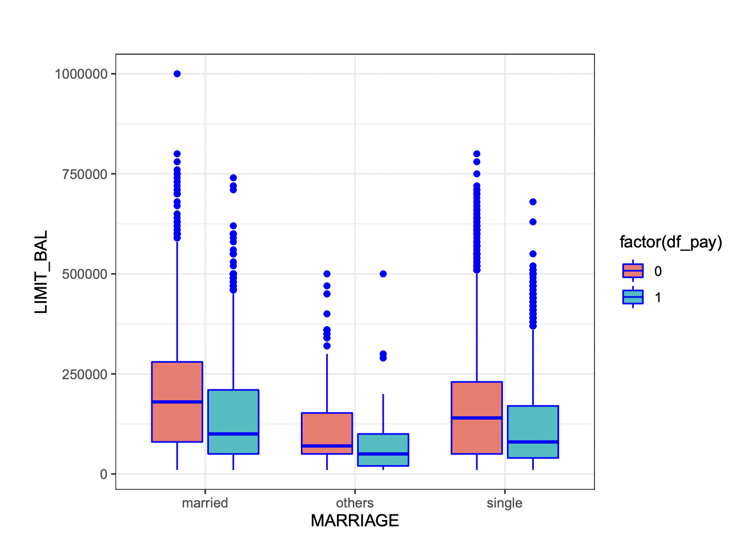
Impact of marital status on payments and credit limit
It can be observed that people who predicted to pay their bills on time were mostly married and have more credit limit

Slide 12
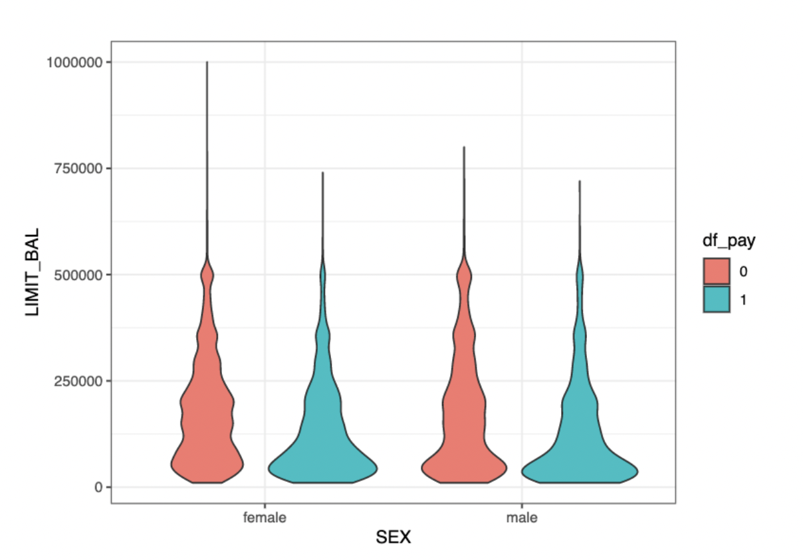
Credit customers and defaulters across gender
Higher density is observed in defaulter customers with credit balance less than 250000 for both genders

Slide 13
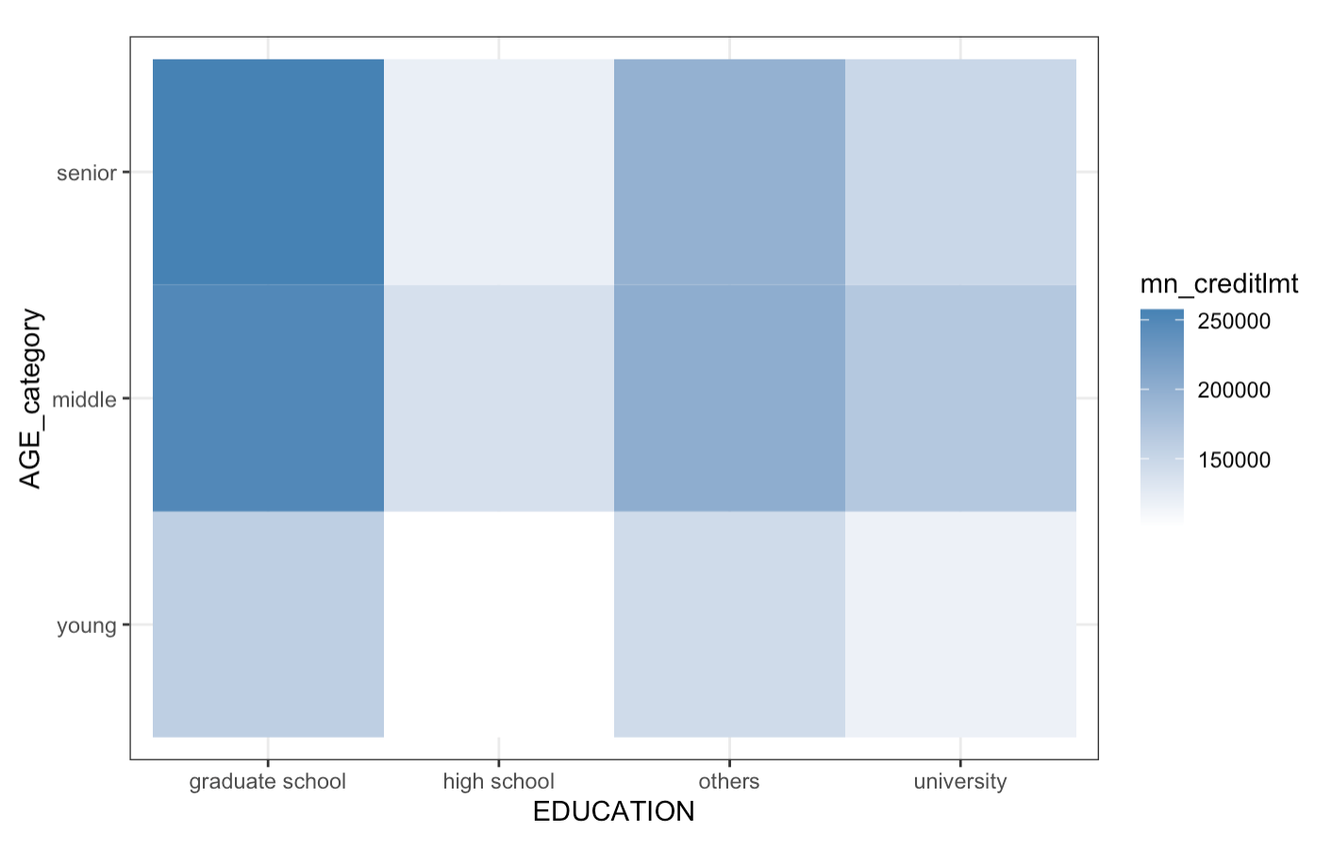
Impact of education and age on credit card limit
Customers who completed graduate school and were in the middle and senior age groups seem to have a higher credit balance. This could be because customers with graduate degrees are more likely to have better paying jobs. This in turn helps them build better reputation with banks leading to higher credit limit

Slide 14
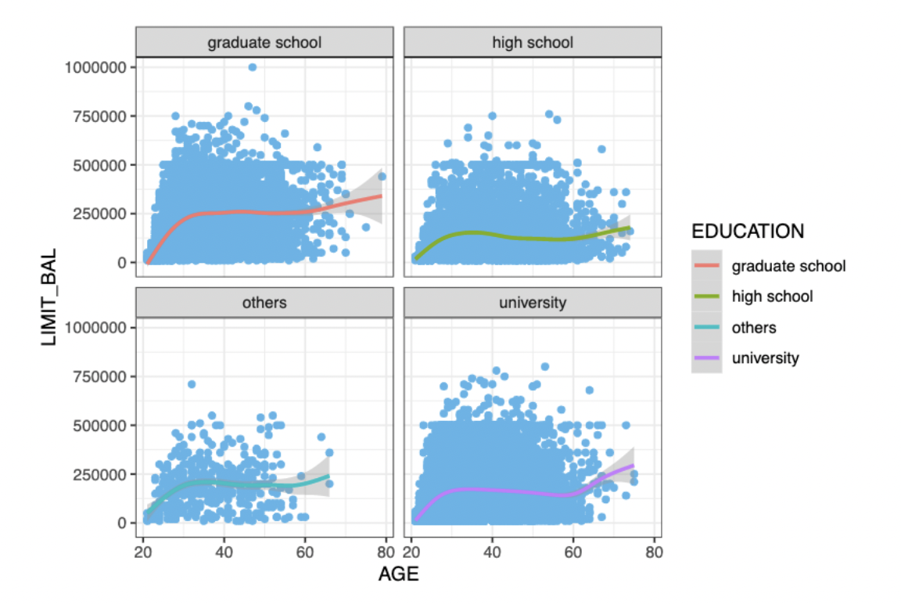
Customer demographics vs limit balance and default status
Customer from “Graduate School (GS)” and “University (Uni)” have similar limit balance pattern (with the former has slightly higher population). Our main customer from GS & Uni background has similar age bracket too, around mid-20s to 50s and since our data doesn’t provide what “Others” Education is, it can be ignored

Slide 15
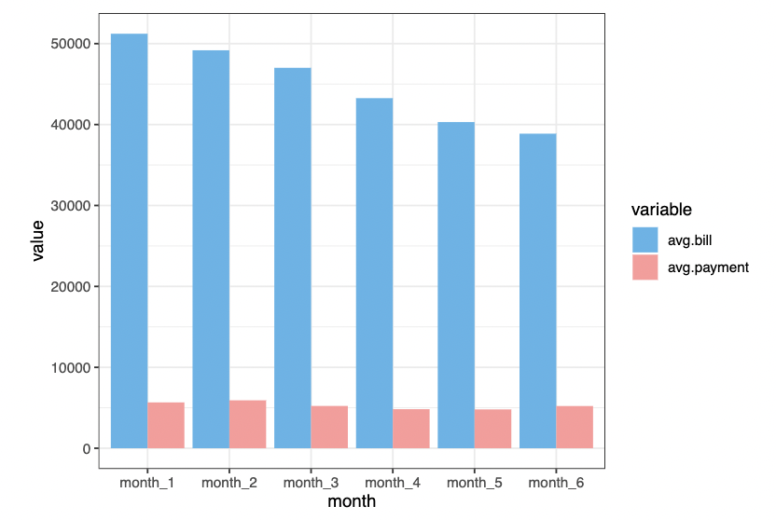
Credit card bill and actual payment for 6 months
The bill is steadily decreased on following months, which makes sense because it was being paid within each month by the customer. The payment proportion is very small compared to the bill, which may be caused by the customer that chose longer installment term so the amount that they have to pay each month is small

Slide 16
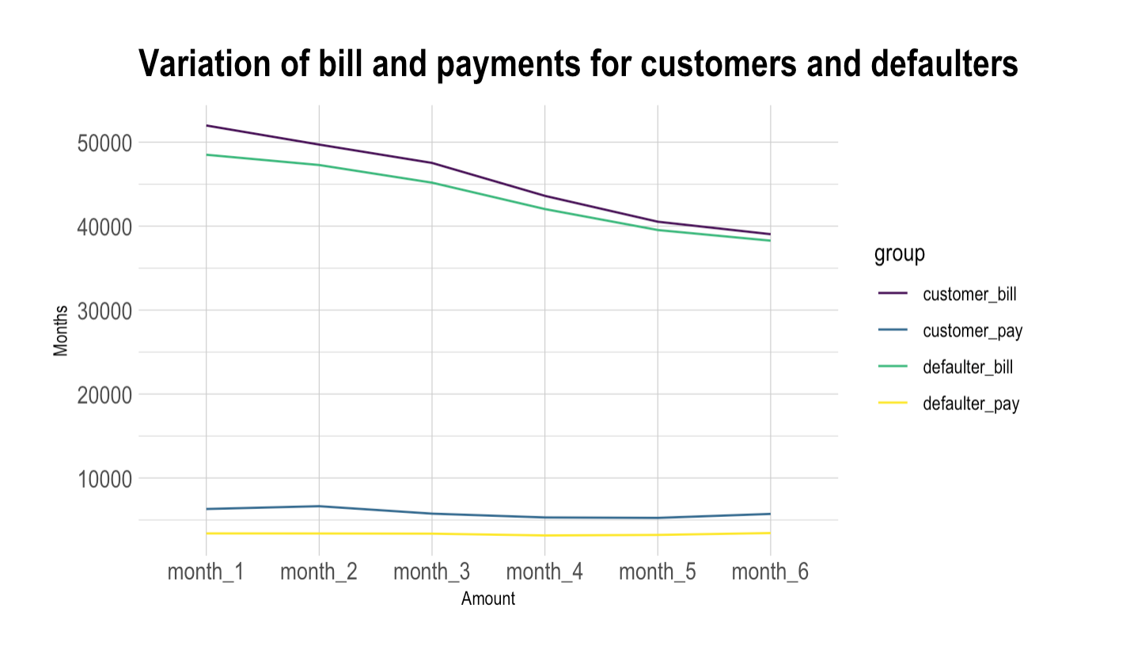
Bills and payments over the months
For both the bill and payments across the 6 months, the average values are significantly higher for the customers who pay their bills on time. This could mean that timely payments is an important factor in predicting the default customers

Slide 17
Conclusion
The better education the lower chances to default.
Having a delay, even for 1 month in any of the previous months, increases the chance of default
The lower the amount of given credit limit of the balance owing, the bigger the chances to default.
Likewise, there are multiple factors influencing the prediction as a default customer. The history of payments is an important factor in predicting the default customers.
Outstanding Debt or payments that haven't been paid is also a significant factor for finding default customers. Predicting default customers is an important task that banks do as they can save a lot of money if the customers are predicted properly.
Banks can either follow up with these customers or put a cap on their credit limit to reduce the losses for banks

Slide 18

Thank You

